Slide 1
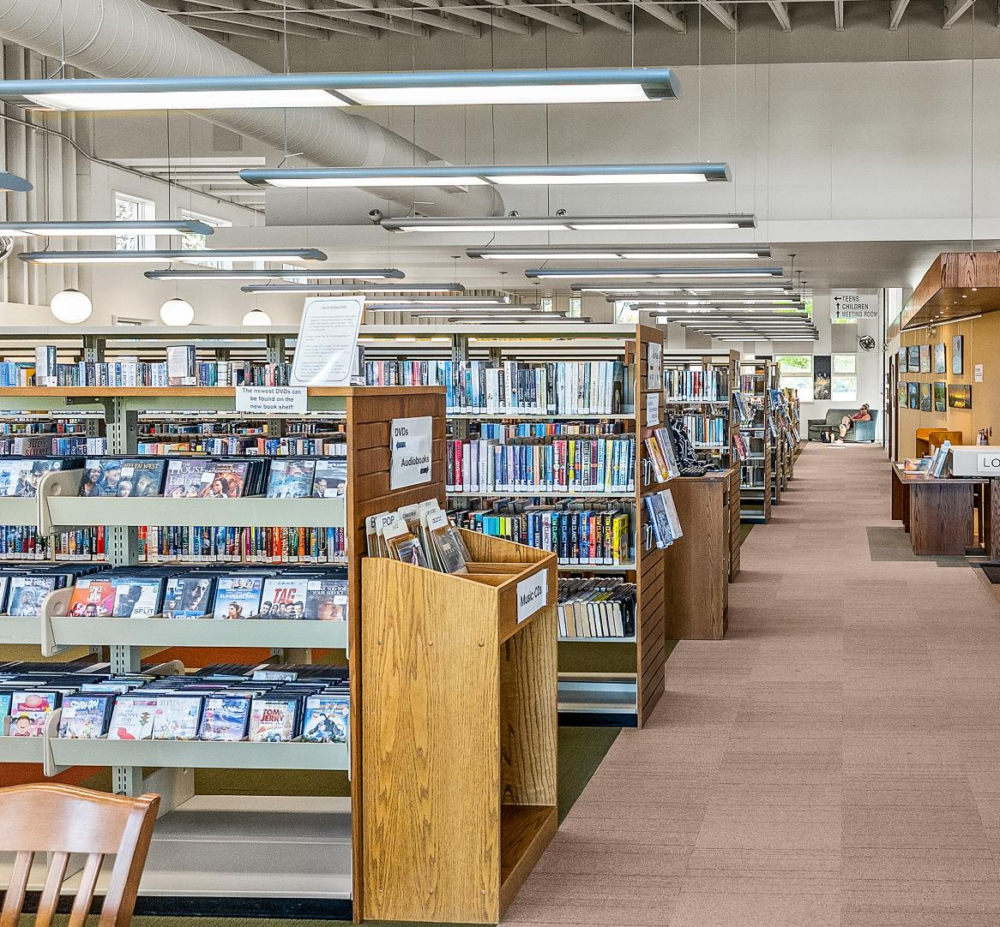

Selwyn Public
Library
Strategic Plan 2026 - 2030

Slide 2
BUILDING FROM STRENGTH
  Strong relationship between the Township staff and council and library staff and board
  Operating from four locations covering all three wards
  Operating an innovative “Makerspace” providing enhanced services to residents
  Large volunteer base that assists staff in servicing residents
  Delivery of extensive children and adult programming well attended by residents
  79,667 physical books borrowed, 35,229 digital checkouts, and 11,208 items borrowed from our special collections in 2025
  1,065 new library and SPL Makerspace cards issued in 2025
  Wide variety of special collection items maintained that serve the unique nature of the Township
  Sources of revenue beyond the levy including - fundraising activities, Causeway Treasure Trove, Ennismore Thrift Shop, and Makerspace revenue

Slide 3
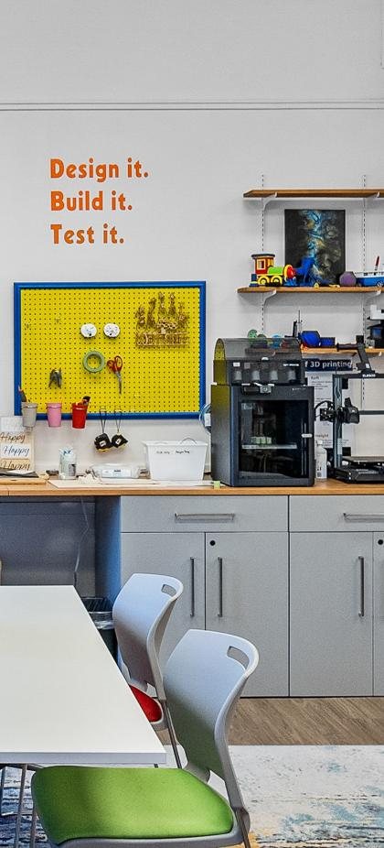
PLANNING PROCESS
  Largely done in house
  Hired a third party to:
    Develop, deploy, compile, and report results of a community survey
    Host Town Halls in each ward and report on results
    Interview staff and compile perspectives
  Board Activities
    Identified emerging challenges needing to be addressed over the next five years
    Reviewed and updated mission, vision and values
    Developed approaches to address identified challenges
    Drafted, edited, and produced the final plan

Slide 4
WHAT WE HEARD FROM THE PUBLIC
Improved and Expanded Spaces | Respondents emphasized the need for more functional and flexible spaces within the library
Extended Library Hours | Many participants expressed a desire for extended or more convenient operating hours
More Programs and Activities | Survey responses reflected interest in both new and expanded programming
Children’s Services and Spaces | Beyond programming, respondents emphasized the need for larger/better equipped children's areas, more educational/interactive material and family friendly environments
Quiet and Work-friendly Environments | Dedicated quiet zones and the creation of meeting rooms
Stronger Community Engagement | Respondents want the library to be more visible and connected in the community
Staff and Customer Service Experience | Respondents identified a need for more staff, well supported volunteers, staff better equipped to provide guidance, particularly as it relates to technology
Makerspace Awareness and Expansion | Respondents expressed a desire for more programs and hands-on workshops, more equipment, and expanded hours

Slide 5

EMERGING CHALLENGES IDENTIFIED
  A reduction in volunteer engagement has placed additional pressure on paid staff resources, affecting the organization’s ability to meet administrative, regulatory, collection, and programming needs
  The cost of new print and digital books is escalating significantly beyond the rate of inflation
  The current physical space within our branches is insufficient to meet the service, programming, and collection demands of projected population growth and demographic changes
  Maximizing the relevance, effectiveness, and return on investment of existing partnerships
  Ensuring our library remains affordable and accessible

Slide 6






STRATEGIC
DIRECTIONS
Ensure adequate funding to sustain ongoing operational functions
Develop and strengthen the library’s human resources
Expand access to programs, services, and collections
The Board has adopted the following strategic direction designed to build on our existing strengths and that address the emerging challenges identified:
Provide sufficient versatile, welcoming, and safe library spaces
Engage the community in developing and promoting resources and partnership opportunities
We have identified twenty-two key initiatives to deliver on our strategic objectives over the next five years.

